Slide 1
Protein Classification through Interaction Network Prediction using Multi-objective Bat Optimization
Presented by
Md. Al-Imran
Registration No: Ha-2367,Session: 2009-2010
Supervised by Md. Shiplu Hawlader Lecturer Department of Computer Science and Engineering University of Dhaka

Slide 2
Contents
Introduction
Motivation
Objective
Background Study
Problem Formulation
Limitation of Existing System
Contribution
Proposed algorithm
Performance Analysis
Future work
Conclusion

Slide 3
Introduction
Protein, one of the most important biological macromolecules
Protein performs a vast array of functions
Human Genome Project has identified over 30,000 genes which may encode about 100,000 proteins[1]
Functions of protein are complex and vary from cell to cell
Function of a protein depends on its 3D structure
Solution of protein structure finding and prediction, is solution to different diseases and drug discovery

Slide 4
Motivation
Protein, a amino acid chain of peptide bond
Protein, a network of amino acid in three dimensional space[2]
The Protein Data Bank (PDB) contains all the information about coordinate of amino acid atoms in protein[3]
Distance and torsion angles between amino acid atoms can be computed
Hydrophobicity is another important properties of amino acid and affect the structure of protein

Slide 5
Objective(1/2)
Predict a network of amino acid atoms
NxN matrix of the graph, representing the network
Edges represents the interaction or bonds between amino acid
Interaction depends not only on distance between amino acid in protein but also the angles between them and on the hydrophobic and hydrophilic properties

Slide 6
Objective(2/2)
Evolutionary Optimization Algorithm is used with capability of multi-objective handling.
Recognize topological properties from the predicted network.
According to those topological properties, classify the protein family by machine learning approach.

Slide 7
Experimental method to Protein Structure
X-ray Crystallography
NMR spectography
Electronic microscopy
Homology modeling (e.g. Swiss model)
Small Angle X-ray Scattering (SAXS)
Small Angle Neutron Scattering (SANS)

Slide 8
Computational approaches to Protein Structure Prediction
Artificial Neural Network (MISMATCH, PHD, NNPREDICT)
Support Vector Machine (SVM)
Nearest Neighbor method
Ab initio protein modeling
Energy and fragment based methods
Evolutionary approach

Slide 9
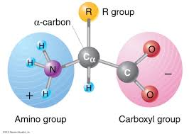
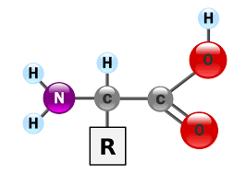
Amino Acid
Amino acids are the building blocks of proteins.
Protein is nothing but sequences of amino acids linked by peptide bonds.
Fig 1: Basic structure of Amino acid

Slide 10
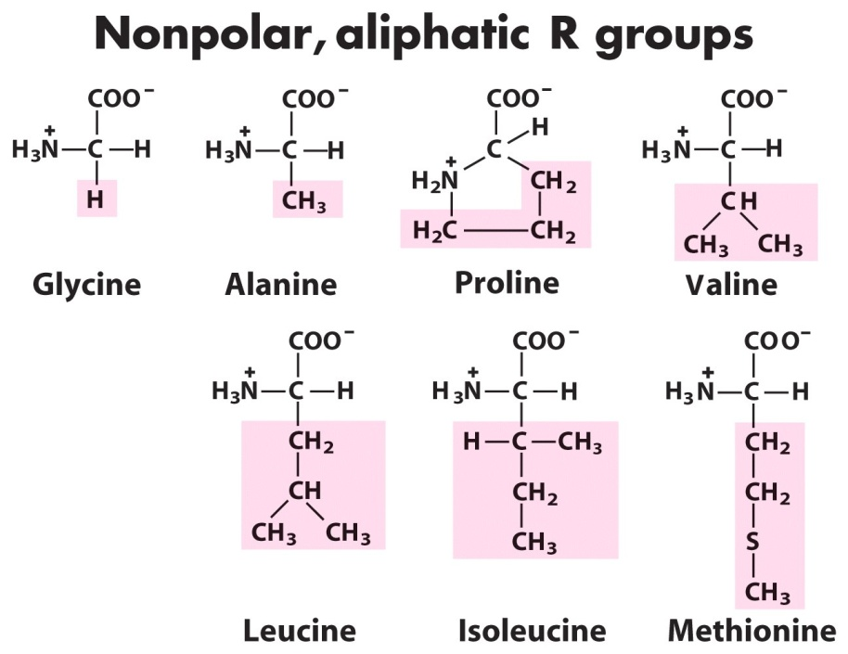
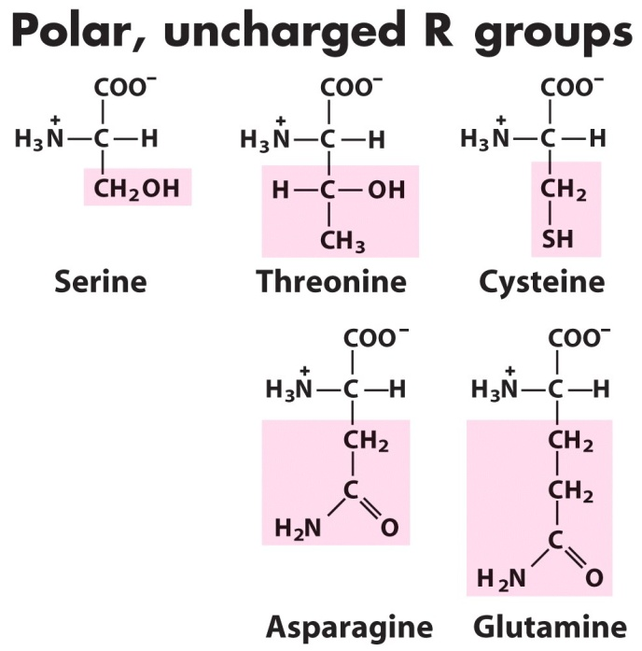
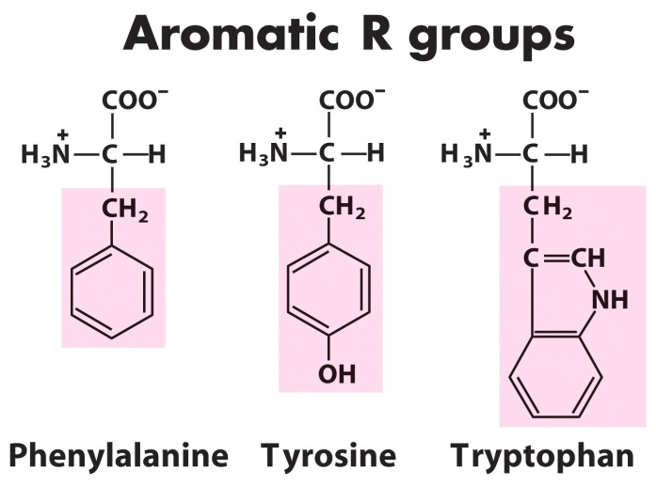
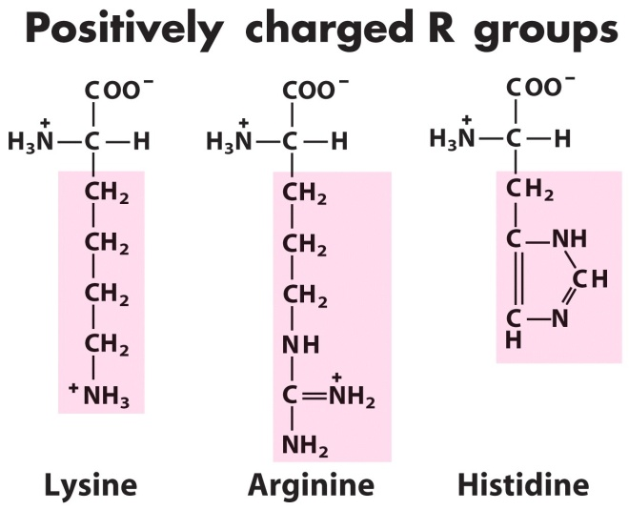
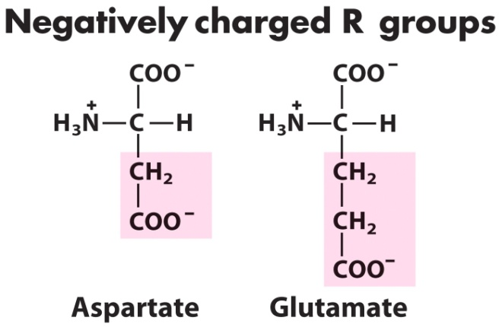
The 20 Amino Acids Found in Protein
Fig 2: Amino Acid residue with different property

Slide 11
Protein Structure
To make a protein, these amino acids are joined together in a polypeptide chain through the formation of a peptide bond.[4]
There are 4 types of protein structure:
Primary Structure.
Secondary Structure.
Tertiary Structure.
Quaternary Structure

Slide 12
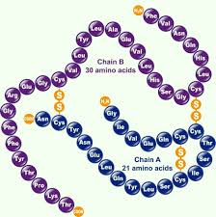
Primary Structure
The primary structure of a protein is the linear sequence of its amino acid
Fig 3: Amino acid chain as protein primary structure

Slide 13
Protein Secondary Structure (1/3)
Secondary structures are 3D state of primary structures
Non-adjacent atomic acids may be connected by hydrogen bond
Distance, torsion angles, hydrophobocity between amino acids defines secondary structure of protein
Two most important secondary structure
Alpha Helix
Beta Sheet

Slide 14
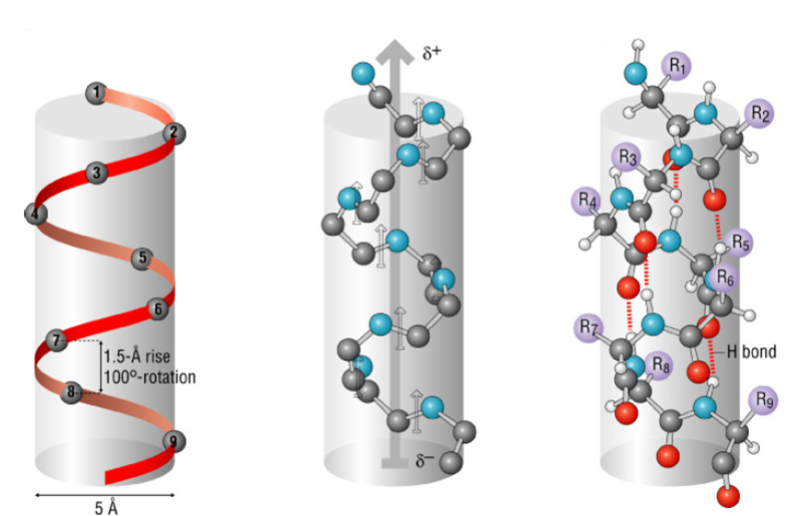
Protein Secondary Structure (2/3)
Fig 4: Alpha Helix

Slide 15
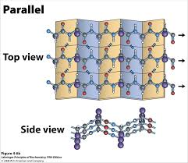
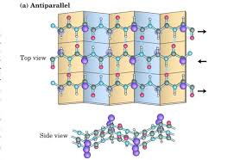
Protein Secondary Structure (3/3)
Fig 5: Beta Sheet (Parallel & Anti-parallel)

Slide 16
Torsion Angles (1/3)
Defines the rotation of the polypeptide chain around the two bonds on both sides of the Cα atom
Provides the flexibility required for the polypeptide backbone to adopt certain structure
Also called Ramachandran angles[5]
Two torsion angles
Phi (φ) angle - between Nitrogen and alpha Carbon (N-Cα) in amino acid chain
Psi (ψ) angle – between alpha Carbon and Carbon (Cα - C) in amino acid chain

Slide 17
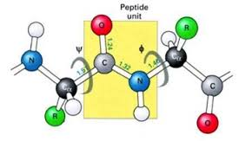
Torsion Angles (2/3)
Fig 6: Torsion Angle

Slide 18
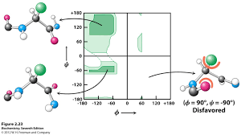
Torsion Angles (3/3)
Fig 7: Ramachandan Plot

Slide 19
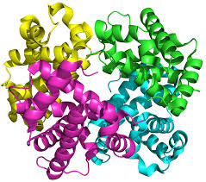
Protein Tertiary Structure
Two or more secondary structure folded together to produce tertiary structure
Each of the secondary structure inside a tertiary structure are called Secondary Structure Element (SSE)
Fig 8: Tertiary Structure of Hemoglobin

Slide 20
Problem Formulation(1/4)
We can define the tertiary structure of the amino acid as a network of amino acid atoms
Vertices represent the amino acid atoms and edges represent interaction between amino acids or bond between them
In a protein structure, some amino acids highly interacts with each other and forms a group or strong network, called Secondary Structure Element (SSE), and this interaction network is called SSE-IN.

Slide 21
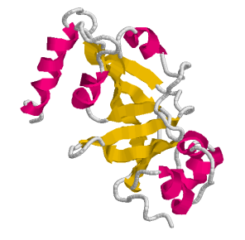
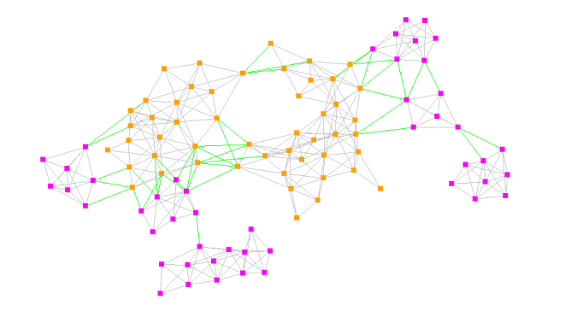
Problem Formulation(2/4)
Fig 9: 1DTP protein and its expected SSE-IN network

Slide 22
Problem Formulation(3/4)
To predict the network we have to solve three problems:
Predict a network of amino acid inter secondary structure element (SSE-IN).
Predict a network of amino acid intra secondary structure element (SSE).
Then merge those two networks to generate the final network.

Slide 23
Problem Formulation(4/4)
To predict the associated protein family we have to solve two problems:
Recognize some graph properties from the predicted final network.
Need to apply a machine learning approach( like ANN, SVM etc).

Slide 24
Related Research works
Two most recent related works are:
Ant Colony Approach to Predict Amino Acid Interaction Networks[6]
Amino Acid Interaction Network Prediction in Protein using Multi-objective Evolutionary Algorithm. [7]

Slide 25
Limitation of Existing System(1/2)
The main limitation of those are pointed as:
Required knowledge: In both of those previous related works, they need to provide the information about it's associate protein family. But in our proposed method we do not need to provide such kind of previous information.
Features: In the 1st one author's consider only distance features of Amino Acid. And in the 2nd work author's consider two features of Amino acid called distance and torsion angle. In our work we also consider another very important feature called hydrophobicity.

Slide 26
Limitation of Existing System(2/2)
Converge Time: Converge time of Bat algorithm is much faster then the previous used algorithms likes, Ant colony or Bee colony algorithm[8].

Slide 27
Contribution
The Key contributions of the work at a glance are as:
A new Framework to predict the Amino Acid Network
Use multi-objective Genetic Algorithm (NSGA-II) to predict the inter SSE (Secondary Structure Element) Network.
Use Bat Algorithm (BA) to find out the intra SSE interaction network.
Recognize topological graph properties from predicted network.
Apply Artificial Neural Network(ANN) to classify the associated protein family.

Slide 28
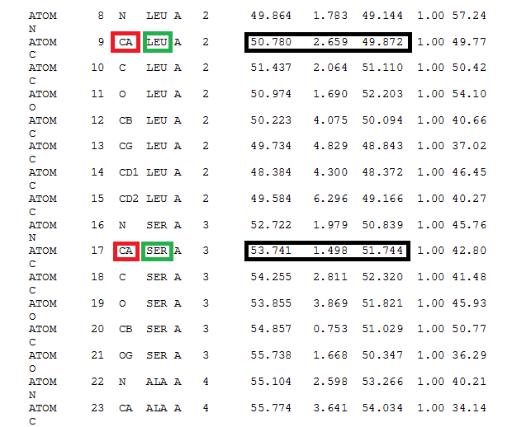
Dataset
Protein Data Bank (PDB) is the Database of protein structure.
From the PDB we can easily get the dataset of a specific protein by the PDB ID.
Fig 10: PDB file of 1a4f.pdb protein

Slide 29
Proposed Algorithm
Three problem 3 solution
Multi-objective Evolutionary Optimization Algorithm to predict inter SSE-IN
Bat Optimization to predict the intra SSE interactions.
Apply machine learning approach to classify.

Slide 30
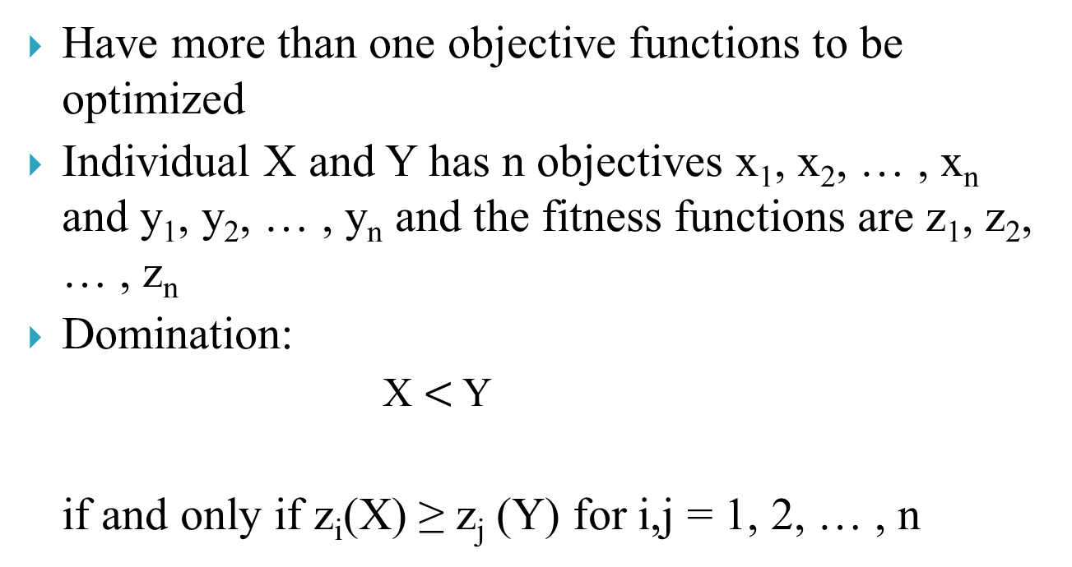
Multi-objective Optimization (1/2)
Have more than one objective functions to be optimized
Individual X and Y has n objectives x₁, x₂, … , x_{n} and y₁, y₂, … , y_{n} and the fitness functions are z₁, z₂, … , z_{n}
Domination:
X $<$ Y
if and only if z_{i}(X) ≥ z_{j} (Y) for i,j = 1, 2, … , n

Slide 31
Multi-objective Optimization (2/2)
Objectives for Amino acid interaction network prediction are:
Distance between amino acids
Nearer the better
Torsion Angles between amino acids
Have to be inside a threshold
Hydrophobicity
Hydrophobic or hydrophilic

Slide 32
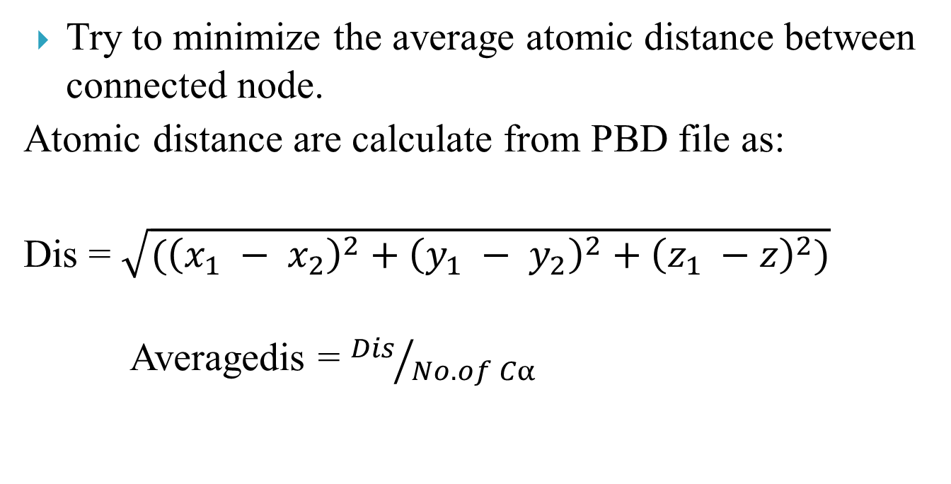
Objective 1 (Distance)
Try to minimize the average atomic distance between connected node.
Atomic distance are calculate from PBD file as:
Dis = $\sqrt{({\left(x_{1} − x_{2}\right)}^{2}+{\left(y_{1} − y_{2}\right)}^{2}+{\left(z_{1} −z\right)}^{2})}$
Averagedis = ${Dis}/{No. of Cα}$

Slide 33
Objective 2(1/3) (Torsion angle)
According to Ramachandan plot[5] we know that, if the torsion angles are in 2nd quadrant of a XY plane than they are bonded and form a Beat Sheet shape and If in 3rd quadrant than they are bonded and form Helix shape.
So we can saw that if the torsion angles into a specific threshold, than the bonding probability between them is high, otherwise the probability is low.

Slide 34
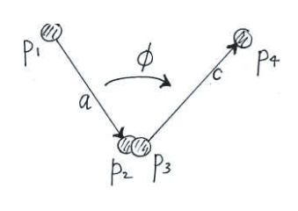
Objective 2(2/3) (Torsion angle)
Torsion angles are calculated from PDB file like as:
If P₁, P₂ P₃ and P₄ are 4 point like above figure then the torsion angles are calculated by below equations:
A = p₂ –p₁
B = p₃ – p₁
C = p₄ –p₃

Slide 35
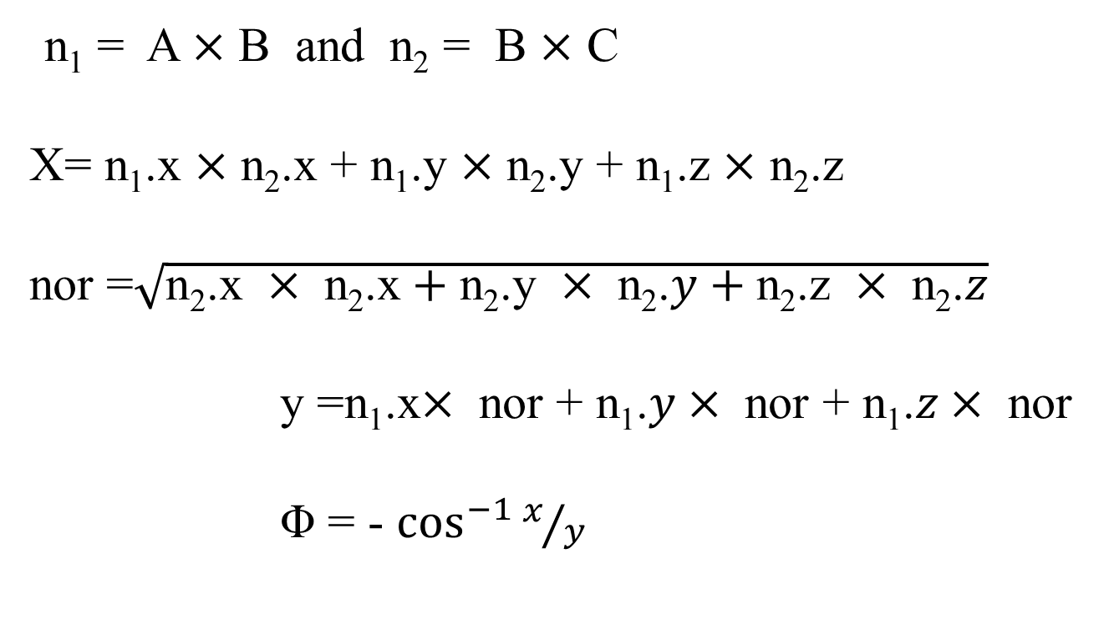
Objective 2(3/3) (Torsion angle)
n₁ = A $×$ B and n₂ = B $×$ C
X= n₁.x $×$ n₂.x + n₁.y $×$ n₂.y + n₁.z $×$ n₂.z
nor =$\sqrt{\text{n}\text{2}\text{.}\text{x} × \text{n}\text{2}\text{.}\text{x}+\text{n}\text{2}\text{.}\text{y} × \text{n}\text{2}\text{.}y+\text{n}\text{2}\text{.}\text{z} × \text{n}\text{2}\text{.}z}$
y =n₁.x$× \text{nor}\text{ + }\text{n}\text{1}\text{.}y× \text{nor}\text{ + }\text{n}\text{1}\text{.}z× \text{nor}$
Φ = - $\cos^{−1}{x/y}$

Slide 36
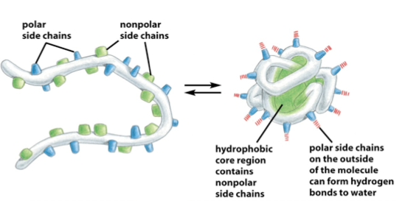
Objective 3(1/3) (Hydrophobicity)
A amino can either Hydrophobic or Hydrophilic.
Same types of amino acid have an affinity to make a bond to each other and distaste the opposite types of atom.
Fig 11: Relationship between Hydrophobicity & protein 3D structure

Slide 37
Objective 3(2/3) (Hydrophobicity)
According to Figure 2, from the PBD file the can easily identify that a protein is Hydrophilic or Hydrophobic
Than just make a XOR operation between them.
If p₁.h is the hydrophobic property of a protein and p₂.h is the hydrophobic property of a another protein, then we calculate the Objective 3 like as :

Slide 38
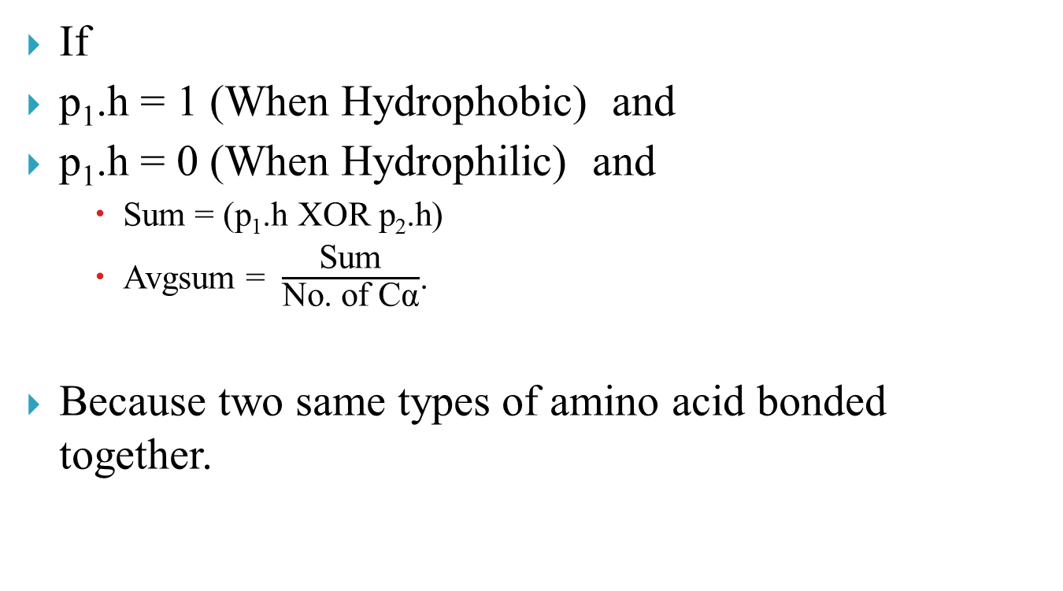
Objective 3(3/3) (Hydrophobicity)
If
p₁.h = 1 (When Hydrophobic) and
p₁.h = 0 (When Hydrophilic) and
Sum = (p₁.h XOR p₂.h)
Avgsum = $\frac{\text{Sum}}{\text{No}\text{. }\text{of} \text{C}\text{α}}$.
Because two same types of amino acid bonded together.

Slide 39
Multi- objective genetic algorithm(1/2)
Genetic Algorithms can provide very efficient solutions for multi-objective optimizations. A generic single objective GA can be modified to find a set of multiple non-dominated solutions in clustering method
Some well Known MOGAs are :
Vector evaluated GA (VEGA).
Niched Pareto GA (NPGA).
Weighted Based GA (WBGA).
Strength Pareto Evolutionary Algorithm (SPEA)
Non-dominated Sorting Genetic Algorithm (NSGA)
SPEA-2
NSGA-II

Slide 40
Multi- objective genetic algorithm(2/2)
As every other algorithms including genetic algorithms for single objective, multi-objective genetic algorithms also have some design issue. It should have a good fitness function, should preserve the diversity in solutions and a good multi-objective genetic algorithm should maintain elitism.
Some Design Issues of MOGA :
Fitness Function Weighted Sum Approach.
Altering objective function
Pareto Ranking Approaches
Diversity Measure
Elitism
We are chose NSGA-II to evaluate our problem.

Slide 41
Flow chart of NSGA-II
Start
Define no. of generation g, Population size P
Define No. of Decision variable V, No. of objective M
Initialize the Population and calculate the initial Fitness
Sort the population according the non domination issue
No
T< g
Select parents by assigned Rank & crowding distance
Generate offspring chromosome by Genetic Operation Crossover & Mutation
Generate Intermediate chromosome = Main chromosome + offspring
Calculate the new fitness
Sort the new population according non domination property
End

Slide 42
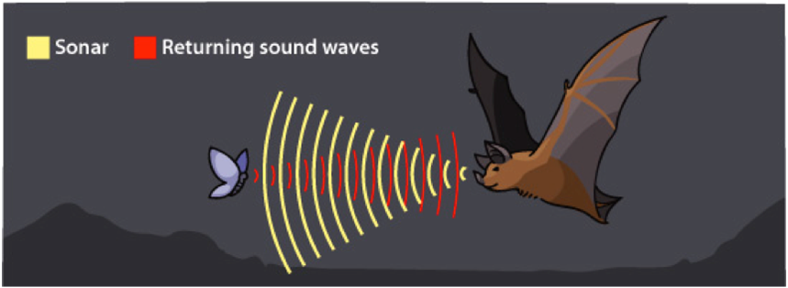
Bat Optimization(1/6)
Bat-inspired algorithm is a meta huheuristic optimization algorithm developed by Xin-She Yang in 2010.
This bat algorithm is based on the echolocation behaviour of micro bats with varying pulse rates of emission and loudness.[8]

Slide 43
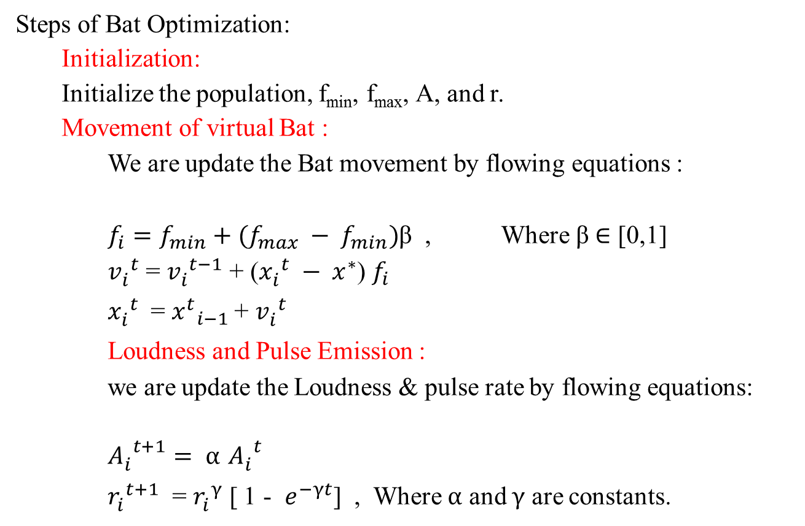
Bat optimization (2/6)
Steps of Bat Optimization:
Initialization:
Initialize the population, f_{min}, f_{max}, A, and r.
Movement of virtual Bat :
We are update the Bat movement by flowing equations :
$f_{i}=f_{min}+(f_{max} − f_{min})$β , Where β $∈$ [0,1]
${v_{i}^{}}_{}^{t}$ = ${v_{i}^{}}_{}^{t−1}$ + (${x_{i}^{}}_{}^{t} − x^{∗}$) $f_{i}$
${x_{i}^{}}_{}^{t}$ = ${{x^{t}}_{i−1}^{}}_{ }^{}$+ ${v_{i}^{}}_{}^{t}$
Loudness and Pulse Emission :
we are update the Loudness & pulse rate by flowing equations:
${A_{i}^{}}_{}^{t+1}= α$ ${A_{i}^{}}_{}^{t}$
${r_{i}^{}}_{}^{t+1}$ = ${r_{i}^{}}_{}^{γ}$ [ 1 - $e^{−γt}$] , Where $α$ and $γ$ are constants.

Slide 44
Bat optimization (3/6)
Make a 3D scenario:
Time delay between emission and detection
3-D scenario
Type & Orientation of Prey
Moving
speed of Prey
Time difference between their two ears
Loudness variations of the echoes
Distance of Prey

Slide 45
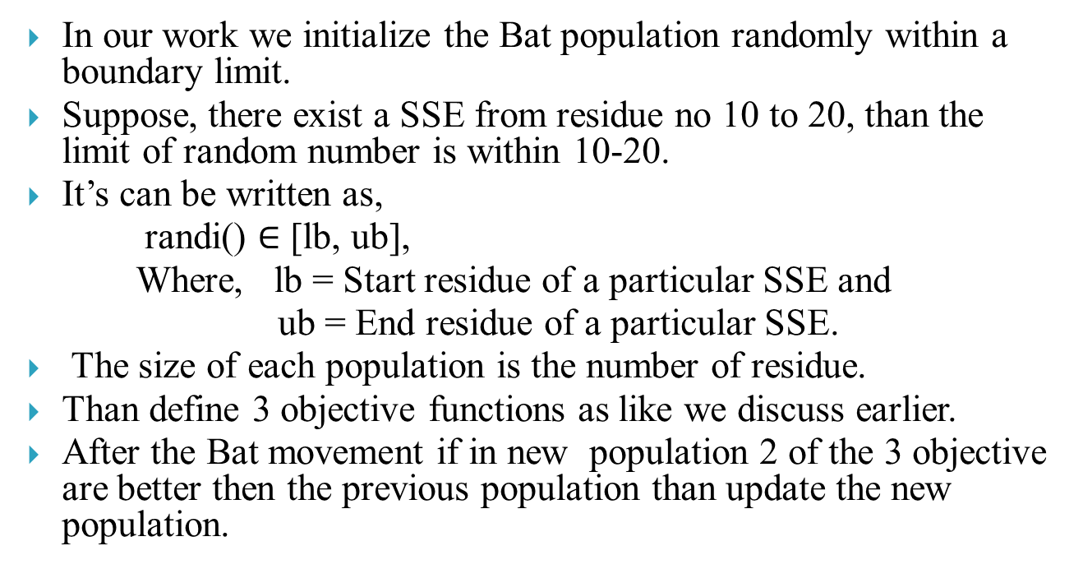
Bat optimization (4/6)
In our work we initialize the Bat population randomly within a boundary limit.
Suppose, there exist a SSE from residue no 10 to 20, than the limit of random number is within 10-20.
It’s can be written as,
randi() $∈$ [lb, ub],
Where, lb = Start residue of a particular SSE and
ub = End residue of a particular SSE.
The size of each population is the number of residue.
Than define 3 objective functions as like we discuss earlier.
After the Bat movement if in new population 2 of the 3 objective are better then the previous population than update the new population.

Slide 46
Flow Chat of Bat optimization
Start
Initialize the Population x_{i}
Define pulse frequency (f_{i} at x_{i})
Initialize pulse rate & loudness (ri and Ai)
No
T< max I
Generate new solution and updating velocities
rand < r_{i}
Select best solution and generate local solution
Generate a new solution by flying randomly
rand< A_{i} & f(x_{i})<f(X*)
Accept new solution
Rank the best and find the current best
End

Slide 47
Bat Algorithm(6/6)
Objective function f (x), x = (x₁, ...,x_{d})^{T}
Initialize the bat population x_{i} (i = 1,2, ...,n) and v_{i}
Define pulse frequency f_{i} at x_{i}
Initialize pulse rates r_{i} and the loudness A_{i}
while(t <Max number of iterations)
Generate new solutions by adjusting frequency, and updating velocities and locations/solutions
if ( rand > r_{i} )
Select a solution among the best solutions
Generate a local solution around the selected best solution
end if
Generate a new solution by flying randomly
if(rand <A_{i} & f (x_{i}) < f (x∗))
Accept the new solutions
Increase r_{i} and reduce A_{i}
end if
Rank the bats and find the current best x∗
end while
Postprocess results and visualization

Slide 48
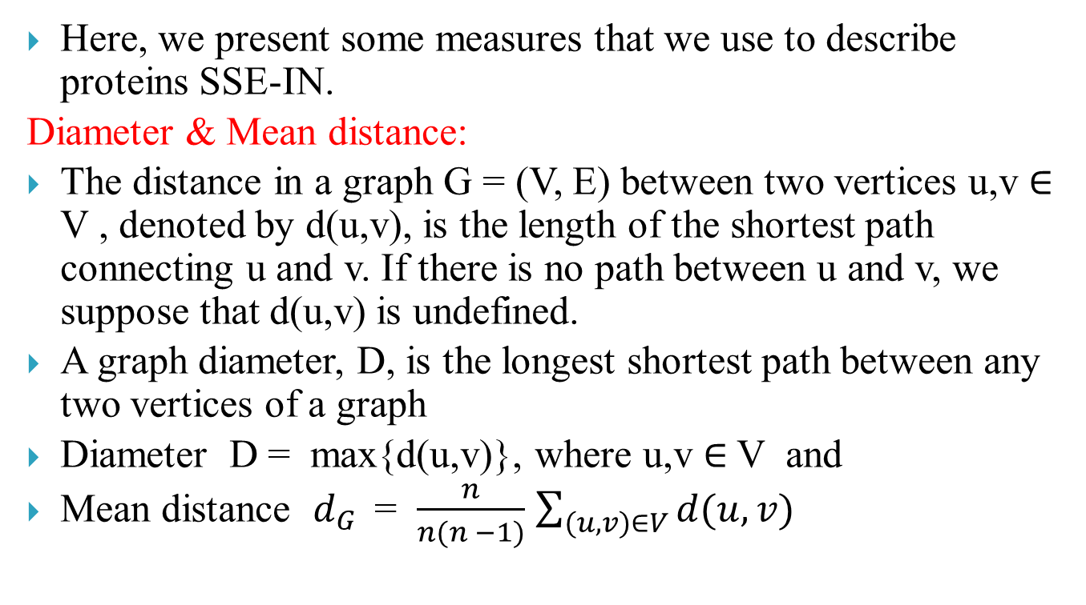
Recognize graph properties(1/2)
Here, we present some measures that we use to describe proteins SSE-IN.
Diameter & Mean distance:
The distance in a graph G = (V, E) between two vertices u,v $∈$ V , denoted by d(u,v), is the length of the shortest path connecting u and v. If there is no path between u and v, we suppose that d(u,v) is undefined.
A graph diameter, D, is the longest shortest path between any two vertices of a graph
Diameter D = max{d(u,v)}, where u,v $∈$ V and
Mean distance $d_{G }$ = $\frac{n}{n(n −1)}$ $\sum_{(u,v)∈V}{d(u,v)}$

Slide 49
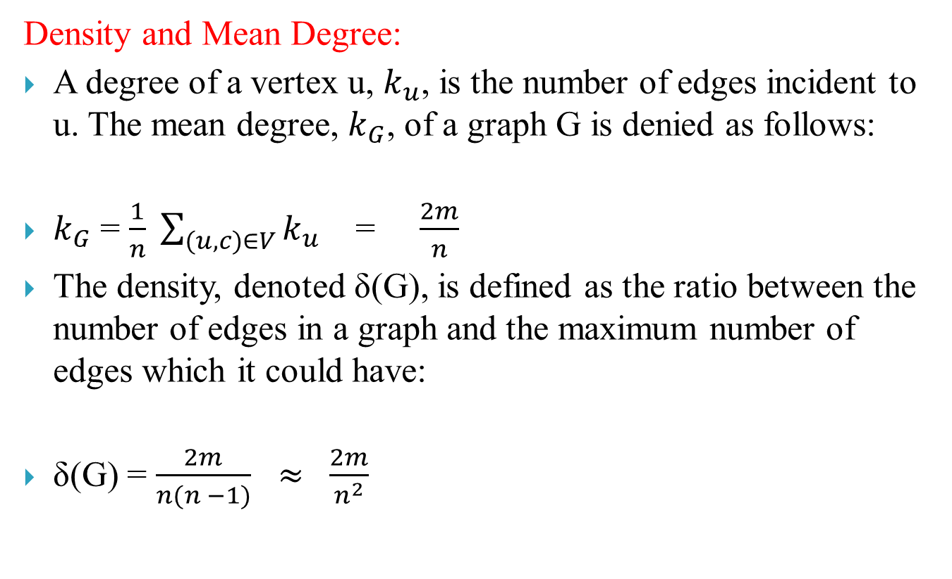
Recognize graph properties(2/2)
Density and Mean Degree:
A degree of a vertex u, $k_{u}$, is the number of edges incident to u. The mean degree, $k_{G}$, of a graph G is denied as follows:
$k_{G}$ = $\frac{1}{n} \sum_{(u,c)∈V}{k_{u}}$ = $\frac{2m}{n}$
The density, denoted δ(G), is defined as the ratio between the number of edges in a graph and the maximum number of edges which it could have:
δ(G) = $\frac{2m}{n(n −1)}$ $≈ \frac{2m}{n^{2}}$

Slide 50
Classify the Associated Protein family(1/3)
In our research work we have also make a classification to predict the associated protein family of an unknown protein based on the our recognized topological properties of a graph.
For this classification we have apply a machine learning approach.
In our work we have choose A multilayer Feed-Forward Neural Network machine learning algorithm (ANN).

Slide 51
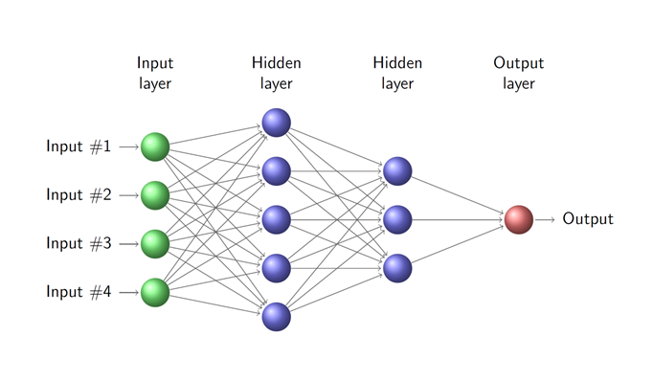
Classify the Associated Protein family(2/3)
Diameter
Density
Mean Degree
Mean Distance
Fig 11: Architecture of an ANN

Slide 52
Flow Chart of ANN
Start
Initialize the input
Define & format network input & target data
Divide data into 3 sets : Training data, Test data, Validation
Create feed forward, back propagation 3 layer network
Train the network
No
Make total error = 0
Apply first pattern & train
Get error for each output neuron & add to total error
No
Current = last pattern
Total Error < final target error
52
End

Slide 53
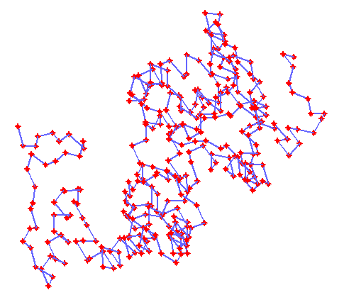
Performance Analysis
“An anion binding site in human aldose reductase: mechanistic implications for the binding of citrate, cacodylate, and glucose 6-phosphate’’ is an protein of human body.
Protein Data Bank(PDB) id of this protein is 3acr.pbd.
This protein have 315 amino acid atoms.
Fig 12: Predicted interaction network of 2acr.pdb protein

Slide 54
Predicted Network
By observed the Figure 12, we can see that, some regions of this network are dense and remain area are sparse.
There also exists few edges between dense and sparse regions.
It means that, this network predicted the intra SSE-IN and inter SSE-IN connections of this protein.

Slide 55
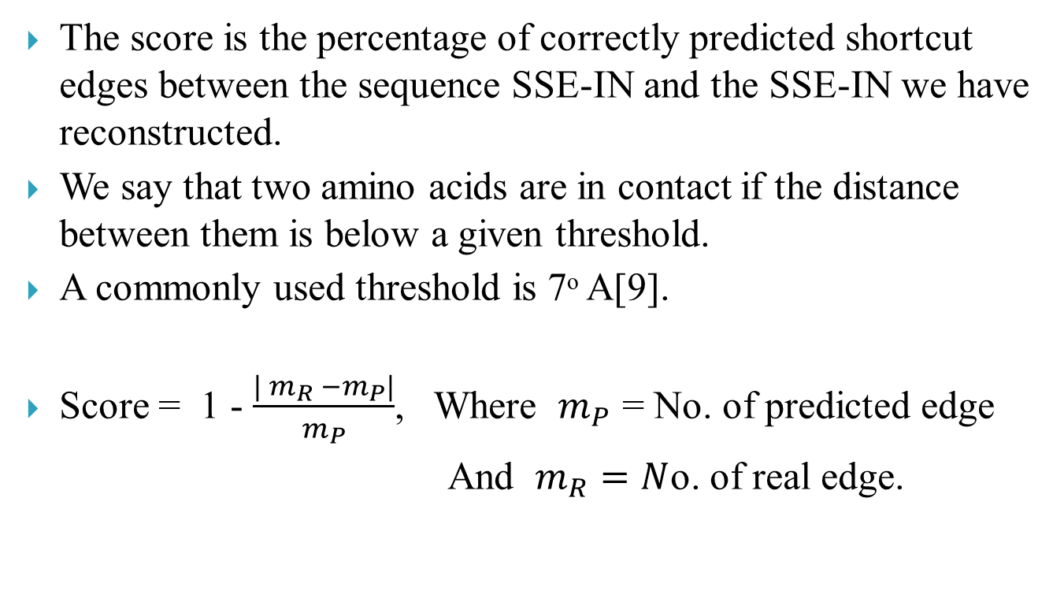
Score Analysis of predicted Network(1/4)
The score is the percentage of correctly predicted shortcut edges between the sequence SSE-IN and the SSE-IN we have reconstructed.
We say that two amino acids are in contact if the distance between them is below a given threshold.
A commonly used threshold is 7ᵒ A[9].
Score = 1 - $\frac{| m_{R} −m_{P}|}{m_{P}}$, Where $m_{P}$ = No. of predicted edge
And $m_{R}=N$o. of real edge.

Slide 56
Score Analysis of predicted Network(2/4)
Protein SCOP family name | Protein Size | Score[6] | Score[7]
All α | 27-46 98-125 129-135 194-200 241-281 377-422 | 79.136 70.69 74.56 68.35 63.37 61.94 | 83.973 73.587 76.125 79.125 63.281 62.072
All β | 54-66 90-111 120-124 125-128 133-224 | 76.13 72.56 76.69 71.3 74.48 | 79.635 74.006 80.881 76.379 77.969
Table 1 : Average Score for SCOP type studied protein family of previous related works

Slide 57
Score Analysis of predicted Network(3/4)
Protein SCOP family name | Protein Size | Score
TIM α/β barrel ( α + β) | 220-260 261-310 311-360 | 86.437 72.090 76.125
Globin-like (all α) | 70-100 101-120 120-140 141-153 | 78.0822 72.5607 68.6954 62.3624
Lysozyme-like ( α/β ) | 100-127 128-140 | 84.8202 82.5369
Table 2 : Average Score for SCOP type studied protein family

Slide 58
Score Analysis of predicted Network(4/4)
Form the table 2 we may saw that, In most cases, the number of edges to add were accurate.
We also observed that, for the least size of protein the score is higher than a large size protein.
By observed table 1 & table 2, we can saw that our framework provide better result without provide any previous knowledge compare to the related work

Slide 59
Measure of calculated graph properties(1/3)
We have applied our proposed method on three different SCOP family, from each family we randomly chose 50 proteins, that became total of 150 protein.
Protein SCOP family | Diameter (D)
Globin-like | 13.61
TIM α / β Barrel | 17.58
Lysozyme | 23.51
Protein SCOP family | Mean distance (z)
Globin-like | 4.12
TIM α / β Barrel | 6.87
Lysozyme | 2.46
Table 3: Average diameter for SCOP type studied protein family
Table 4: Average of mean distance for each family

Slide 60
Measure of calculated graph properties(2/3)
Protein SCOP family | Mean degree( k_{G})
Globin-like | 25.25
TIM β/ α Barrel | 18.02
Lysozyme-like | 12.52
Protein SCOP family | Density
Globin-like | 0.074
TIM β/ α Barrel | 0.1831
Lysozyme-like | 0.1038
Table 5: Average of mean degree for each SCOP family
Table 6: Densityfor each SCOP family

Slide 61
Measure of calculated graph properties(3/3)
According to table 3, 4, 5 and 6 we can claim that the diameter and mean degree are strongly depends on the associated protein family.
And also obverse that, diameter and mean degree are have a inversely proportional relation.

Slide 62
Result of classification(1/3)
After observed the result analysis of topological properties, we claim some of the properties are depends on protein family.
In other words, we may say that the associate protein family are depends on those properties.
So, it is possible to make a classifier according to those properties.
We used 100 proteins, data to train our Artificial Neural Network(ANN). After that test 50 data to classify the associated protein family on three different SCOP family.

Slide 63
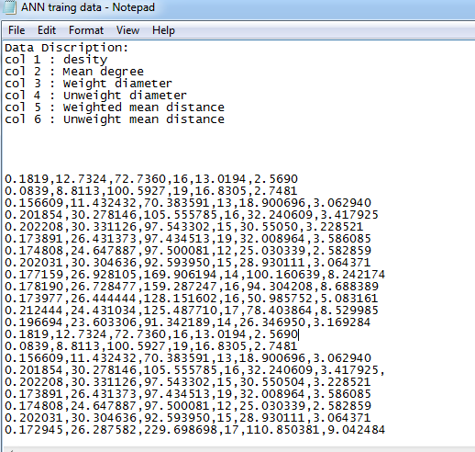
Result of classification(2/3)
Fig 13: A screen shot of training data for ANN

Slide 64
Result of classification(3/3)
Protein SCOP family | Classification Accuracy
Globin-like | 81.1%
TIM α / β Barrel | 64.45%
Lysozyme-like | 92.23%
Overall | 79.36%
Table 7: Classification result for each SCOP family

Slide 65
Result Summary
From the performance analysis, we can claim that our framework provides better amino acid interaction network without providing any previous information in contrast to the previous related works [6] [7].
Also from the analysis, of graph properties we can claim that, our framework provides some meaning-full properties of amino acid interaction network, which were the main features to the machine learning approach to classify a protein family in computational way.
After observing all the result, we can say that our proposed method is a improvement compare to previous related works in terms of result as well as breadth of the research.

Slide 66
Future Work
There were some limitation in our research methods those we want to overcome in future. Some of our intended future improvements are as follows:
Improvement in multi-objective handling in Bat optimization
Improvement in objective functions
Parallelization
Extend more property of the predicted network

Slide 67
Conclusion(1/2)
We have proposed an computational solution to an biological problem.
We have proposed a framework to predict the secondary structure element (SSE) network of protein.
According to our proposed framework The first problem was solve by an multi-objective genetic algorithm and the second one solve by Bat optimization approach.
Due to adding another property of protein, hydrophobicity our proposed framework provides better network than the previous related research works.

Slide 68
Conclusion(2/2)
Due to the faster computational complexity and convergence time of Bat algorithm, the proposed framework is faster than related previous works.
In the later half of the thesis, after predicting the amino acid interaction network, we have extended some graph theory properties from the network, and those properties are the key to find the associate family of an unknown protein.
In the last part of the thesis, we have proposed a machine learning approach on the graph properties to classify the protein according to their associated protein family.

Slide 69
References
[1] E. Pennisi. A low number wins the genesweep pool. In Science, volume 300, page 1484,2003.
[2] L. Li N. V. Dokholyan, F. Ding, and E. I. Shakhnovich. Topological determinants of protein folding. In Proceedings of the National Academy of Sciences of the United States of America, volume 99, pages 86378641, 2002.
[3] Helen M Berman, John Westbrook, Zukang Feng, Gary Gilliland, TN Bhat, Helge Weissig, Ilya N Shindyalov, and Philip E Bourne. The protein data bank. Nucleic acids research, 28(1):235242, 2000.
[4] Carl Branden, John Tooze, et al. Introduction to protein structure, volume 2. Garland New York, 1991.
[5] Debnath Pal and Pinak Chakrabarti. On residues in the disallowed region of the ramachandran map. Biopolymers, 63(3):195206, 2002.
[6] Gaci Omar Balev Stefan. Ant colony approach to predict amino acid interaction
networks. In World Congress on Nature & Biologically Inspired Computing, volume 1,
pages 1725{1730, 2009.
[7] Amino Acid Interaction Network Prediction Using Multi-Objective Optimization Md. Shiplu Hawlader and Saifuddin Md. Tareeq, 2014
[8]. X.-S. Yang, A New Metaheuristic Bat-Inspired Algorithm, in: Nature Inspired Cooperative Strategies for Optimization (NICSO 2010) (Eds. J. R. Gonzalez et al.), SCI 284, 65-74 (2010).
[9]Dokholyan Nikolay V, Li Lewyn, and Ding Feng Shakhnovich Eugene I. Topological determinants of protein folding. Proceedings of the National Academy of Sciences,99(13):8637{8641, 2002.

Slide 70



